Slide 1
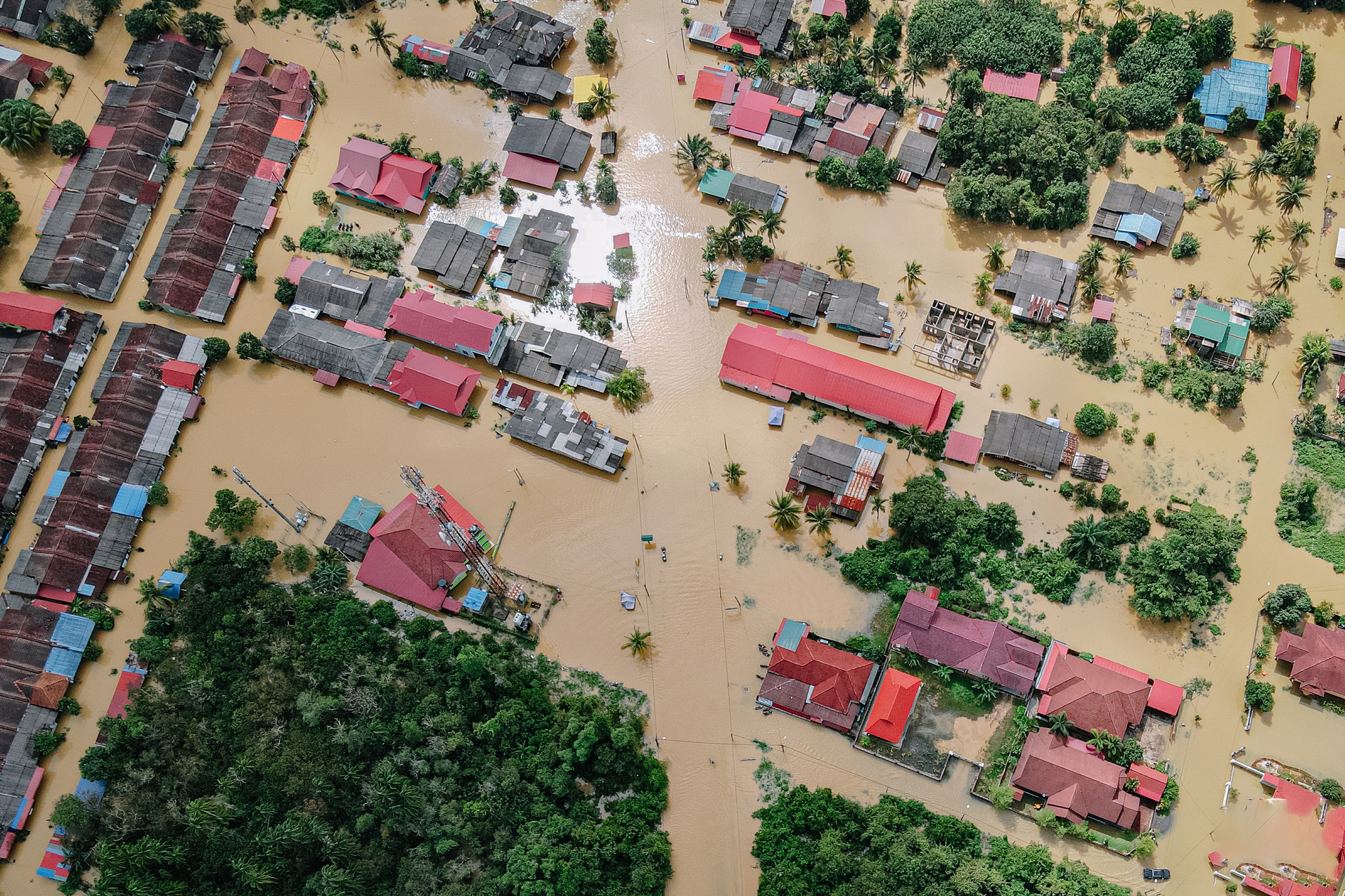
Uttarakhand flood
Chamoli disaster
By: Pranav
IX B
Roll no. 21

Slide 2




Table of Contents
Introduction
Uttarakhand flood
Causes Behind the Disaster
Impact of the Disaster

Slide 3


Table of Contents
Emergency Rescue and Relief Operations by Different Agencies
Conclusion

Slide 4
Introduction
UTTARAKHAND FLOOD
The 2021 Uttarakhand flood, also known as the Chamoli disaster, began on 7 February 2021 in the environs of the Nanda Devi National Park, a UNESCO World Heritage Site in the outer Garhwal Himalayas in Uttarakhand state, India

Slide 5
Introduction
UTTARAKHAND FLOOD
It was caused by a large rock and ice avalanche consisting of material dislodged from Ronti peak. It caused flooding in the Chamoli district, most notably in the Rishiganga river, the Dhauliganga river, and in turn the Alaknanda. At least 72 people confirmed to have been killed.

Slide 6
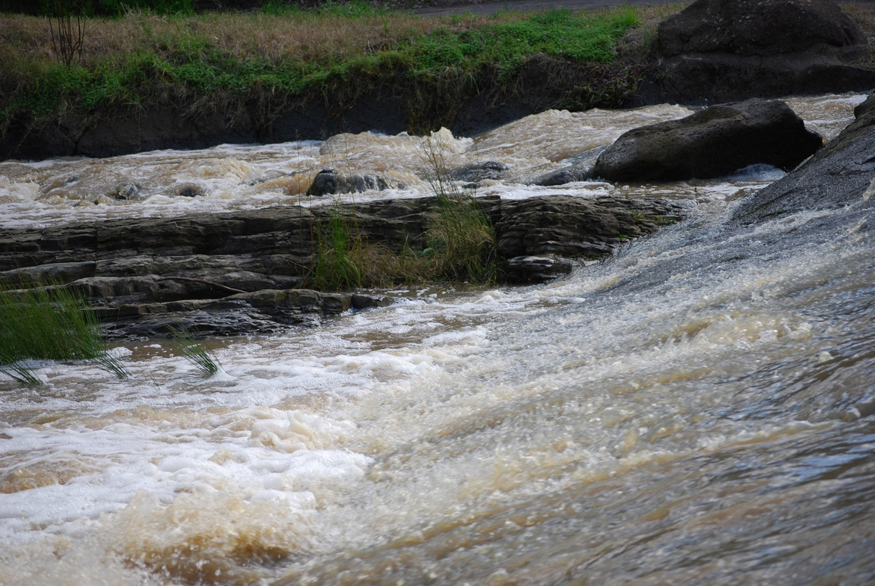
CHAMOLI DISASTER
WHY?
Causes Behind the Disaster

Slide 7
Causes Behind the Disaster
UTTARAKHAND FLOOD
The incident on February 7, 2021, caused by a landslide, an avalanche or a glacial lake outburst flood in the Rishiganga river damaged the lives and livelihoods of several people.

Slide 8
Causes Behind the Disaster
UTTARAKHAND FLOOD
Flood was caused by a portion of glacier being torn away and causing a landslide
In June 2021, the International Charter 'Space and Major Disasters' published a study that confirmed a large rock and ice avalanche as the cause of the disaster.

Slide 9
Causes Behind the Disaster
UTTARAKHAND FLOOD
The reports estimate the avalanche at about 27 million cubic meters, consisting of 80% rock and 20% glacier ice. The glacier ice became water over the course of the 3.2km elevation difference from the height , which further worsened the impact by causing a debris flood wave.

Slide 10
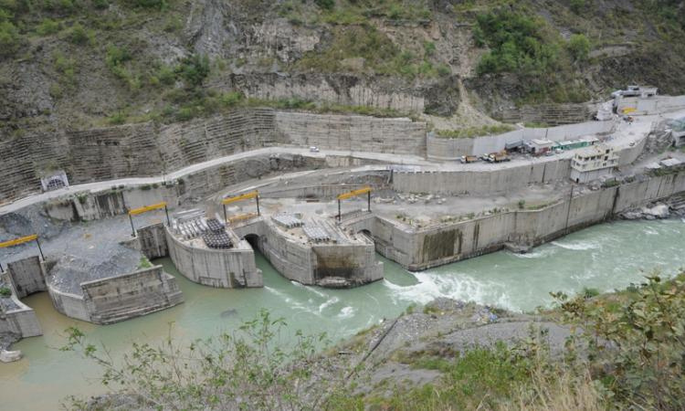
CHAMOLI DISASTER
Impact of the Disaster

Slide 11
TWO MAJOR IMPACTS
4 Hydropower Projects Damaged
More than 72 People Killed

Slide 12
Impact of the Disaster
UTTARAKHAND FLOOD
The event caused damage to four hydropower projects along the Rishi Ganga, Dhauliganga and Alaknanda river path. The Rishi Ganga Hydropower Project near Raini village, located 14 km downstream from the impact site , was the first to be hit by the flood after the rockslide.

Slide 13
Impact of the Disaster
UTTARAKHAND FLOOD
The Rishiganga power project on the Rishiganga river, a , was damaged badly and 35 laborers working on the project are missing. The Chamoli district in Uttarakhand appeared to have been hit hardest by the surging Dhauliganga River.

Slide 14
Impact of the Disaster
UTTARAKHAND FLOOD
Senior police officials told media that a bridge in the Tapovan area that connected 13 villages was washed away in the avalanche
Among the places most severely hit by the floods are Joshimath, Rini, Nanda Devi National Park, Tapovan Vishnugad Hydropower Plant and Sridhar.

Slide 15
400
300
200
100
0
Deaths
Missing
Injured

Slide 16

CHAMOLI DISASTER
Emergency Rescue and Relief Operations

Slide 17
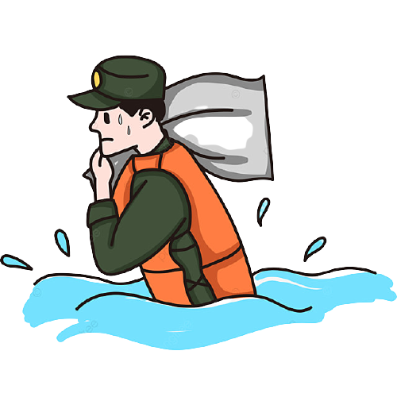
Many villages were evacuated as authorities emptied two dams farther down the river to stop the floodwaters from reaching towns of Haridwar and Rishikesh. Two C-130J Super Hercules with 3 teams of National Disaster Response Force (NDRF) have been deployed in the rescue mission.

Slide 18

Uttarakhand chief minister Trivendra Singh Rawat has announced Rs 4 lakh as compensation for the deceased. Prime Minister Narendra Modi had also announced an extra of Rs 2 lakh for the family of those killed in the disaster and Rs 50,000 to the injured.

Slide 19

CHAMOLI DISASTER
Conclusion

Slide 20
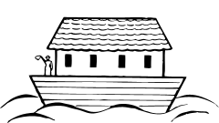
Conclusion
The first is that putting resources into hazard mitigation and
emergency preparedness is perhaps the best investment a country
can make.

Slide 21
Conclusion
The second relates to the importance of building strong institutional
coordination and adequate financing mechanisms.

Slide 22
Conclusion
The third lesson is the need to put communities at the center of the construction process and train them for such natural calamities.

Slide 23
Thank you!

